Slide 1
MGFN : Magnitude-Contrastive Glance-and-Focus Network
for Weakly-Supervised
Video Anomaly Detection

Slide 2
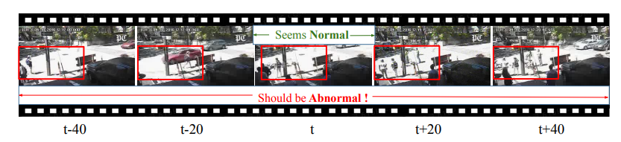
Notes:
The image illustrates the importance of long-term temporal context in anomaly detection within surveillance videos:
Frame t-40: Shows a scene that appears normal, with no obvious anomalies detected within the red bounding box.
Frame t-20: Also seems normal, continuing to show the scene without any apparent anomalies in the highlighted area.
Frame t: Marked as "Should be Abnormal!" indicating that at this point in the video sequence, an anomaly is present or starting to occur, although it may not be evident without additional context.
Frame t+20: The scene still looks normal in the snapshot, suggesting the anomaly is not continuous or immediately obvious.
Frame t+40: Similar to frames t-40 and t-20, this frame on its own appears normal, which emphasizes the challenge in detecting anomalies based solely on single-frame analysis.
The sequence highlights that an anomaly in surveillance footage might not be noticeable in a single frame and that evaluating frames over time is crucial for accurate detection.

Slide 3
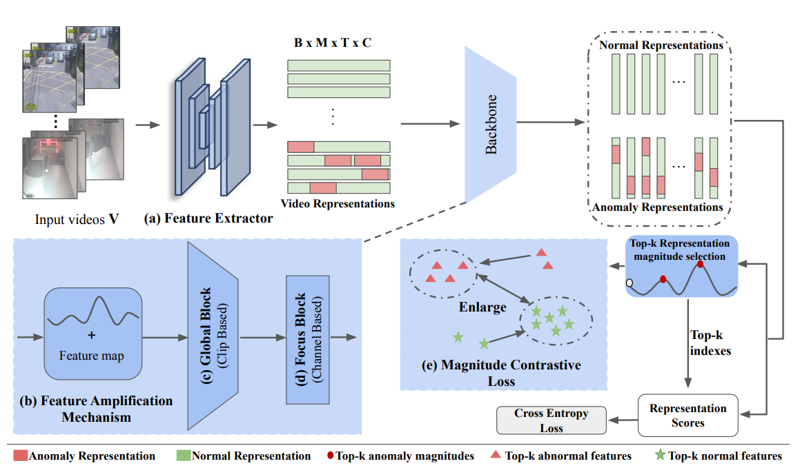
Notes:
1) Input and Feature Extraction
The MGFN framework begins by processing input videos (both normal and abnormal) through a feature extractor, which translates the raw video data into a structured format that is suitable for further analysis.
2) Feature Amplification Mechanism
Post feature extraction, the Feature Amplification Mechanism (FAM) computes the magnitude of features and integrates them explicitly as a residue, enhancing the feature representation and preparing it for the subsequent analysis blocks.
3) Glance and Focus Blocks
The Glance Block (GB) captures global context information, providing an overview of the entire video sequence, while the Focus Block (FB) enhances local features, allowing for detailed analysis of specific video segments.
4) Magnitude Contrastive Loss
The Magnitude Contrastive (MC) loss is then employed to improve the separability of normal and abnormal features. It does so by minimizing the distance between feature magnitudes within the same category and maximizing the distance between different categories, utilizing the top-k normal and abnormal feature magnitudes.
5) Final Scoring:
The network concludes by selecting the top-k representation magnitudes, which contribute to the final anomaly scores calculated using a cross-entropy loss function, effectively distinguishing between normal and abnormal events in the input videos.

Slide 4
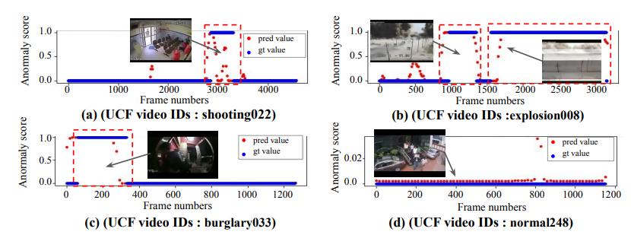
Notes:
The image shows graphs representing anomaly detection results by the MGFN model on videos from UCF-crime and XD-violence datasets:
Anomaly Score Graphs: Each graph plots anomaly scores as predicted by the MGFN (red points) against frame numbers for different videos, with scores ranging between 0 (normal) and 1 (anomalous).
Ground Truth Comparison: Red boxes highlight the frames where anomalies actually occur (ground truth), allowing for a visual comparison between the predicted values and the true anomaly periods.
UCF Crime Dataset Results: Graphs (a) to (d) show results for four different videos from the UCF Crime dataset, labeled with specific IDs like 'shooting022' and 'burglary033', demonstrating the model's performance in detecting various types of anomalies.
Prediction Accuracy: The alignment of the red points (predicted values) with the red boxes (ground truth values) indicates the accuracy of the MGFN in detecting temporal anomalies within the video frames. Discrepancies would suggest false positives or false negatives in the model's predictions.

Slide 5
1. ".../MGFN./option.py" Code
Purpose: Defines a function parse_args() to parse command-line arguments using argparse.
Argument Definitions: Specifies various arguments for the program such as feature extractor type, feature size, modality, paths to data lists and ground truth files, and other hyperparameters like dropout rate and learning rate.
GPU Settings: Sets the environment variable CUDA_VISIBLE_DEVICES based on the --gpus argument, allowing the specification of GPUs to be used.
Argument Parsing: Uses argparse.ArgumentParser to handle command-line arguments and returns the parsed arguments.
Flexibility: Allows easy modification and experimentation with different settings by changing command-line arguments.

Slide 6
2. "../MGFN./train.py" Code
Loss Functions: Defines custom loss functions, including contrastive loss, sparsity, and smoothness loss, for training the model.
Training Function: Contains the train function which performs the forward pass and backpropagation on the training data.
Model Update: Updates the model parameters using the computed loss and optimizer.
Loss Computation: Combines multiple loss functions to compute the total loss for each training step.
Utility Functions: Provides functions to compute specific types of losses based on the model's outputs and training data.

Slide 7
3. ".../MGFN./main.py" Code
Training and Testing Setup: Initializes configurations, data loaders, and model for training and testing using a deep learning model.
Model Initialization: Loads a pre-trained model if available, sets up the device (GPU/CPU) for training, and initializes the optimizer.
Training Loop: Iterates over epochs, trains the model on the training data, and computes metrics like AUC and PR AUC on the test data.
Logging and Saving: Writes training and test results to a CSV file and uses tensorboardX for logging. Saves the best model based on performance metrics.
Configuration Management: Saves the configuration and model parameters to a file for reproducibility.

Slide 8
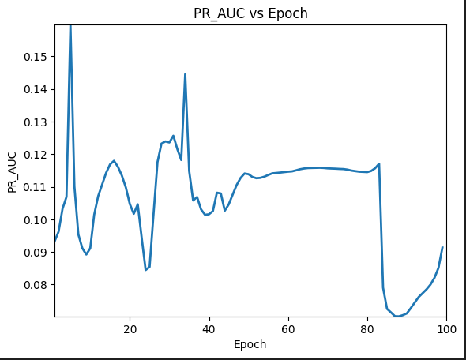
Notes:
The PR_AUC starts high and fluctuates early, indicating initial learning volatility.
PR_AUC stabilizes in the middle epochs, suggesting consistent model performance.
A sharp drop in PR_AUC near epoch 80 indicates a significant performance decrease.
Subsequent recovery implies the model may be overcoming previous issues.
Overall, the graph shows instability in model performance over epochs, highlighting potential areas for model improvement.

Slide 9
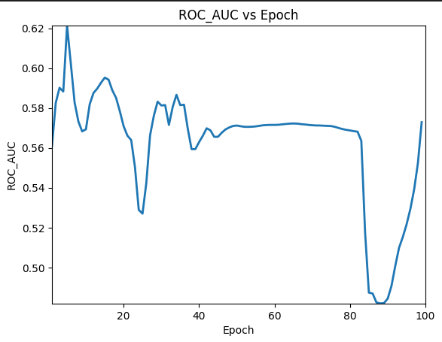
Notes:
Initial volatility in ROC_AUC suggests the model is learning but not yet stable.
Moderate ROC_AUC values indicate average model discrimination ability between classes.
The graph shows a plateau, where the ROC_AUC doesn't improve significantly, suggesting possible underfitting or an ineffective learning phase.
A sharp decline near epoch 80 points to a sudden decrease in model performance, which could be due to overfitting or an inappropriate update to the model.
The final upswing in ROC_AUC may indicate the model's recovery from the performance dip, possibly due to a beneficial change in training dynamics.

